Slide 1
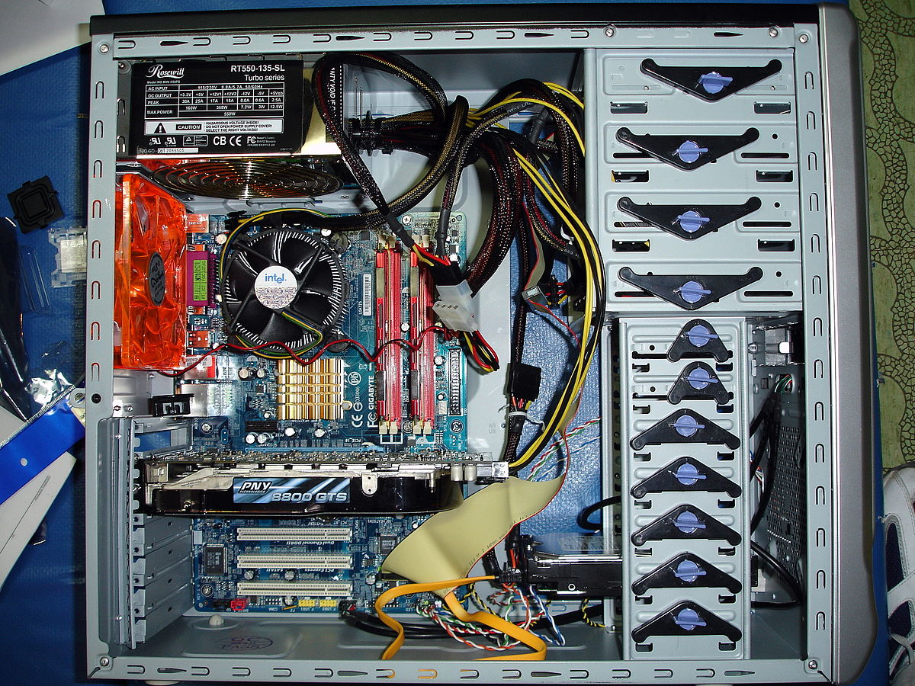
Dvd ports
fan
Fan
Mother Board
R.A.M
Graphics card
Hard disk

